Slide 1


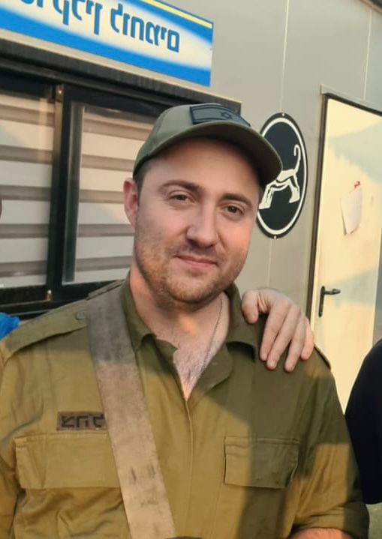
Course: Image Processing 31651
Assignment #31
Geometrical Transforms
Photo of the student | Shorten Name | ID (4 last digits)
 | shienfeld | 1950 | Student #1
 | pony | 2210 | Student #2
 | akimov | 7939 | Student #3
Photo of the student | Shorten Name | ID (4 last digits)
 | shienfeld | 1950 | Student #1
 | pony | 2210 | Student #2
 | akimov | 7939 | Student #3

Slide 2
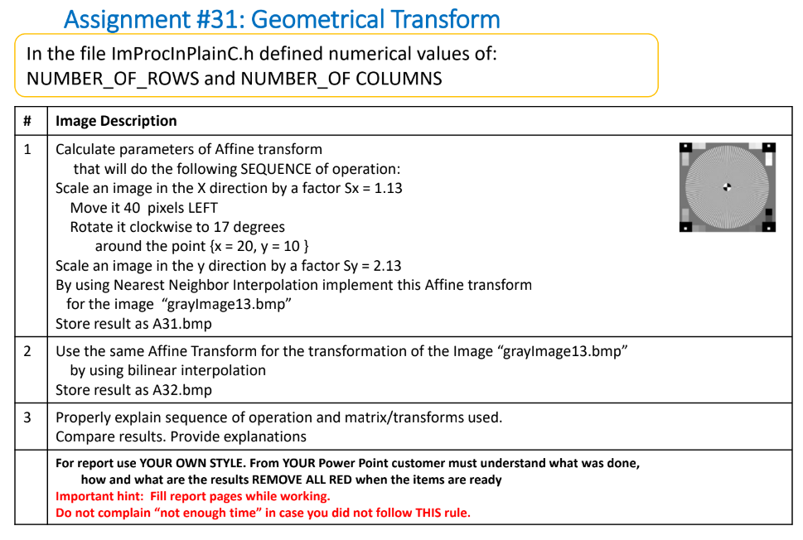

Slide 3
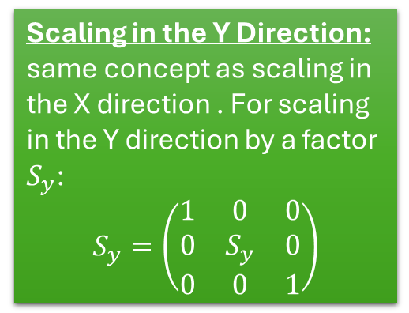
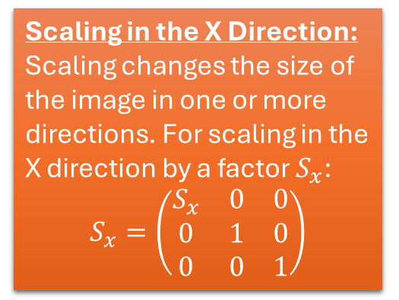
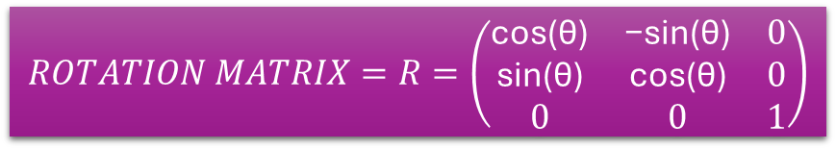
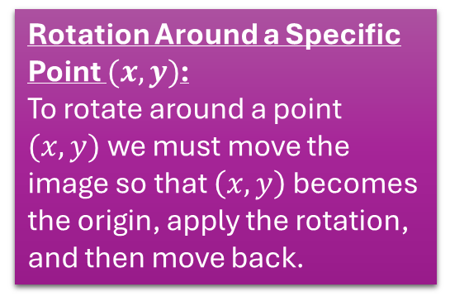
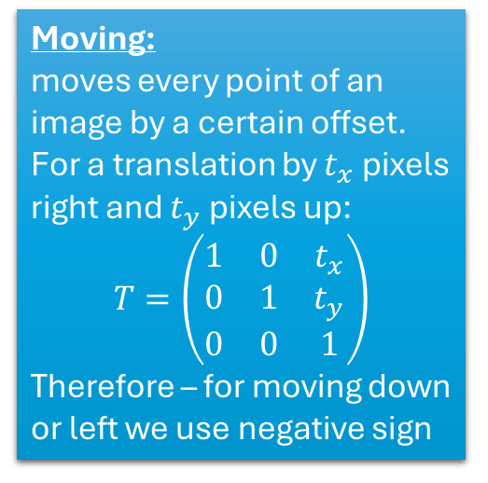
31.1 – mathematical background about affine transformations-part 1
We are going to use several affine transformations according to the demand of the task – all the transformations (operations) will be modeled using matrix operations :
Scaling in the X Direction:
Scaling changes the size of the image in one or more directions. For scaling in the X direction by a factor $S_{x}$:
$$S_{x}=\left(\begin{matrix}S_{x} & 0 & 0 \\ 0 & 1 & 0 \\ 0 & 0 & 1\end{matrix}\right)$$
Scaling in the Y Direction:
same concept as scaling in the X direction . For scaling in the Y direction by a factor $S_{y}$:
$$S_{y}=\left(\begin{matrix}1 & 0 & 0 \\ 0 & S_{y} & 0 \\ 0 & 0 & 1\end{matrix}\right)$$
Rotation Around a Specific Point $(x,y)$:
To rotate around a point $(x,y)$we must move the image so that $\left(x,y\right)$ becomes the origin, apply the rotation, and then move back.
Moving:
moves every point of an image by a certain offset.
For a translation by $t_{x}$pixels right and $t_{y}$ pixels up:
$$T=\left(\begin{matrix}1 & 0 & t_{x} \\ 0 & 1 & t_{y} \\ 0 & 0 & 1\end{matrix}\right)$$
Therefore – for moving down or left we use negative sign
$$ROTATION MATRIX=R=\left(\begin{matrix}\text{cos}\text{(}\text{θ}\text{)} & \text{−}\text{sin}\text{(}\text{θ}\text{)} & 0 \\ \text{sin}\text{(}\text{θ}\text{)} & \text{cos}\text{(}\text{θ}\text{)} & 0 \\ 0 & 0 & 1\end{matrix}\right)$$

Slide 4
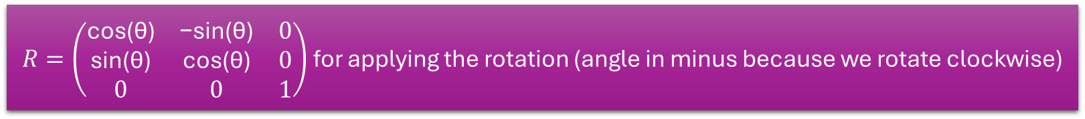
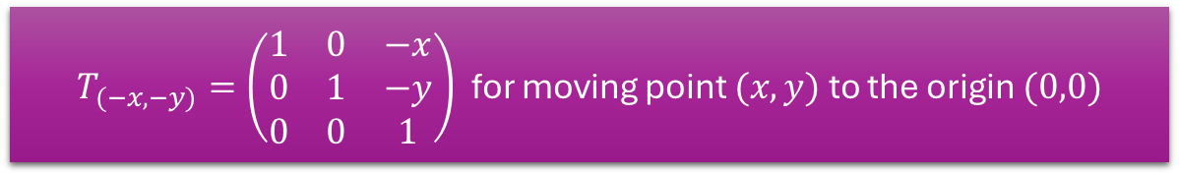
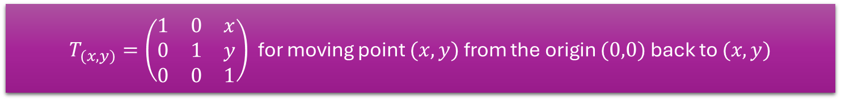
31.1 – mathematical background about affine transformations-part 2
The total matrix for the operation of “Rotate it clockwise to 17 degrees
around the point {x = 20, y = 10 } ” will be comprised of the 3 matrix (=3 steps)
$T_{(−x,−y)}=\left(\begin{matrix}1 & 0 & −x \\ 0 & 1 & −y \\ 0 & 0 & 1\end{matrix}\right)$for moving point $(x,y)$ to the origin $(0,0)$
$R=\left(\begin{matrix}\text{cos}\text{(}\text{θ}\text{)} & \text{−}\text{sin}\text{(}\text{θ}\text{)} & 0 \\ \text{sin}\text{(}\text{θ}\text{)} & \text{cos}\text{(}\text{θ}\text{)} & 0 \\ 0 & 0 & 1\end{matrix}\right)$ for applying the rotation (angle in minus because we rotate clockwise)
$T_{(x,y)}=\left(\begin{matrix}1 & 0 & x \\ 0 & 1 & y \\ 0 & 0 & 1\end{matrix}\right)$for moving point $(x,y)$ from the origin $(0,0)$ back to $(x,y)$
The total matrix operation for the rotation is : $R_{around (x,y)}=T_{(x,y)}∗R∗T_{(−x,−y)}$

Slide 5

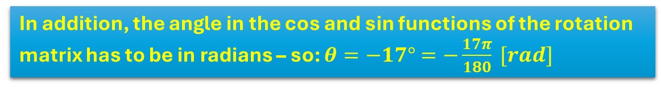
31.1 – mathematical background about affine transformations-part 3
The total matrix for the operation of will be comprised of the 6 matrix (=6 steps):
$$A=S_{y}∗T_{\left(x,y\right)}∗R∗T_{\left(−x,−y\right)}∗T∗S_{x}$$
The task is : “Scale an image in the X direction by a factor Sx = 1.13 , Move it 40 pixels LEFT , Rotate it clockwise to 17 degrees around the point {x = 20, y = 10 } ,
Scale an image in the y direction by a factor Sy = 2.13.
The total matrix for the operation with final numbers will be :
$$A=S_{2.13}∗T_{\left(20,10\right)}∗R∗T_{\left(−20,−10\right)}∗T∗S_{1.13}$$
In addition, the angle in the cos and sin functions of the rotation matrix has to be in radians – so: $θ=−17°=−\frac{17π}{180} [rad]$

Slide 6
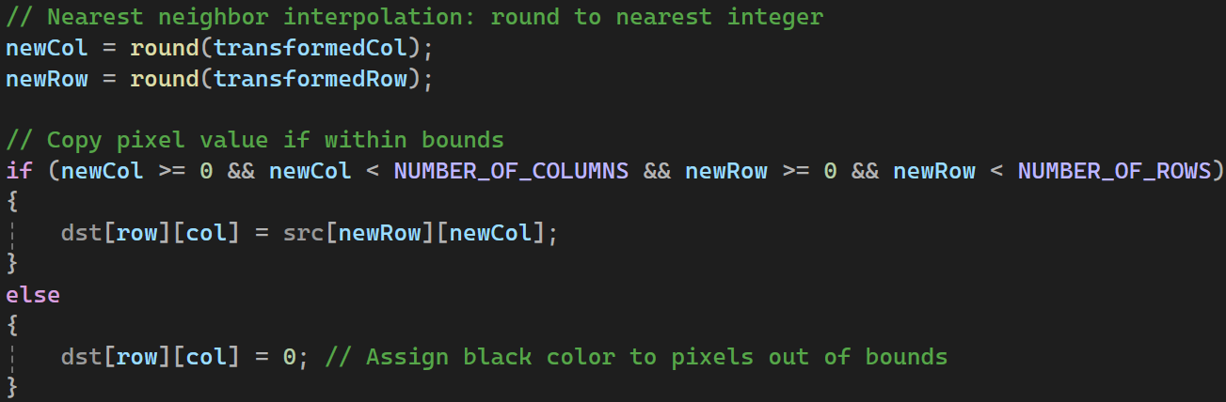
31.2 – implementation of the Nearest Neighbor Interpolation in code
Nearest Neighbor Interpolation is the simplest interpolation method.
When transforming an image, it selects the value of the nearest pixel to the transformed coordinates.
Essentially, it rounds the transformed coordinates to the nearest integer and uses the pixel value at that location.
Round the transformed coordinates to the nearest integers. The rounding lead to the selection to the nearest pixel in the input image.
Finally, copy the pixel value from the nearest neighbor in the input image to the current position in the output image.

Slide 7
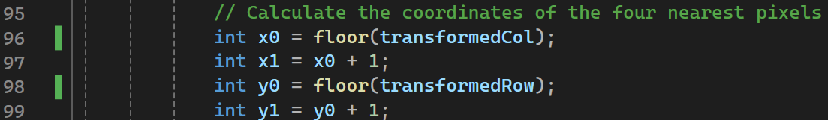
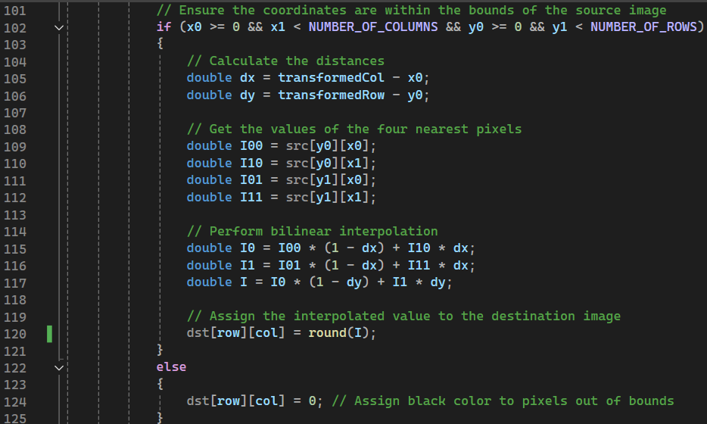
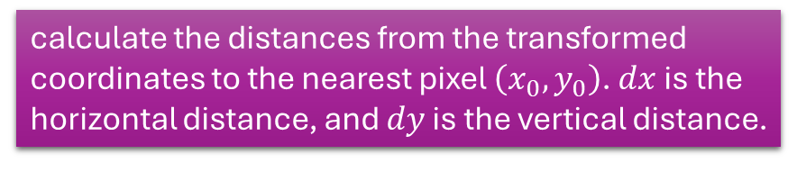
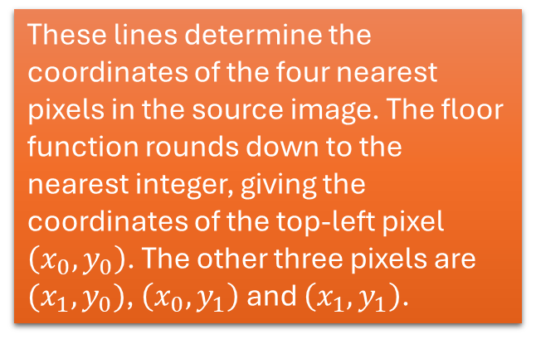
31.3 – implementation of the bilinear interpolation in code
The bilinear interpolation calculates the intensity of a pixel in the transformed image by interpolating between the intensities of the four nearest pixels in the source image. This provides a smoother and more accurate result compared to the nearest neighbor interpolation.
These lines determine the coordinates of the four nearest pixels in the source image. The floor function rounds down to the nearest integer, giving the coordinates of the top-left pixel
$\left(x_{0}, y_{0}\right)$. The other three pixels are $(x_{1}, y_{0})$, $\left(x_{0}, y_{1}\right)$and $\left(x_{1}, y_{1}\right)$.
The if checks if the nearest pixels are within the bounds of the source image. If they are out of bounds, the destination pixel is set to black (0).
calculate the distances from the transformed coordinates to the nearest pixel $\left(x_{0}, y_{0}\right)$. $dx$ is the horizontal distance, and $dy$ is the vertical distance.
retrieve the intensity values of the four nearest pixels from the source image.
The first two lines interpolate the pixel intensities horizontally. The last line interpolates these values vertically to get the final intensity I
The round function is for converting the floating-point intensity value to the nearest int

Slide 8
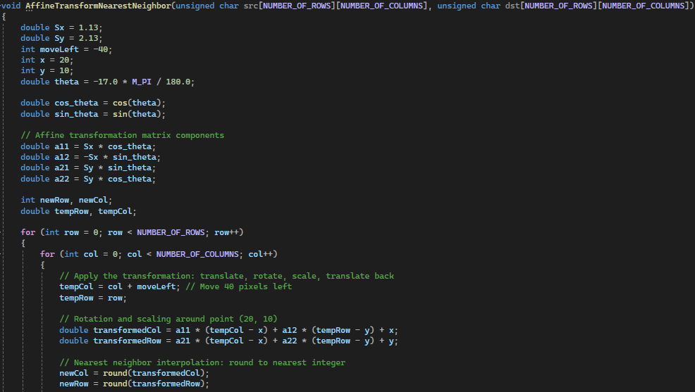
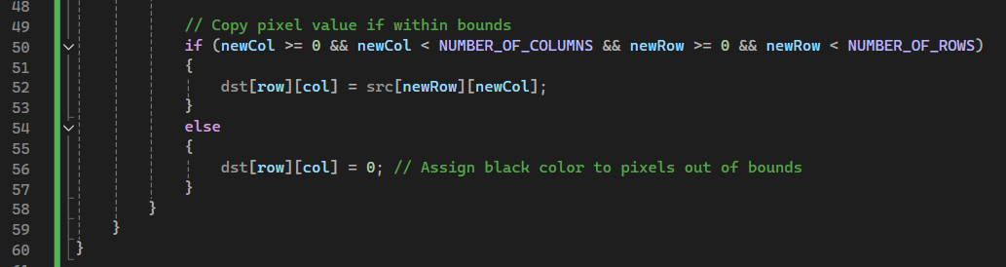
31.4 – “NearestNeighborInterpolation” function – part 1
The end of the function:

Slide 9
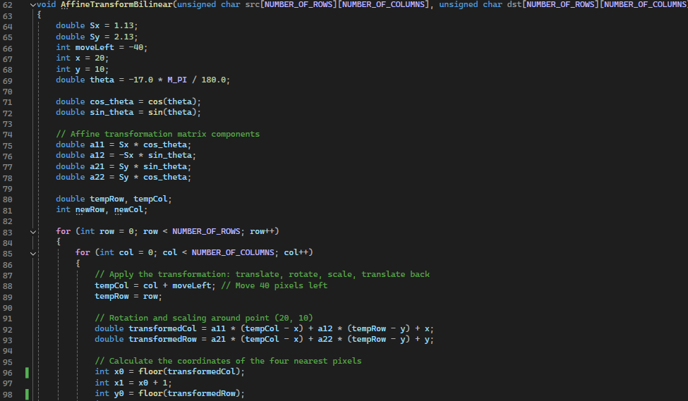
31.5 – “AffineTransformBilinear” function – part 1

Slide 10
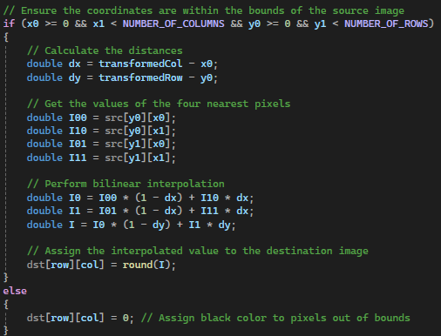
31.6 – “AffineTransformBilinear” function – part 2

Slide 11
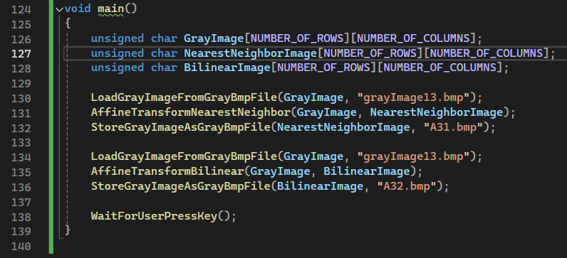
31.7 – the “main” function

Slide 12
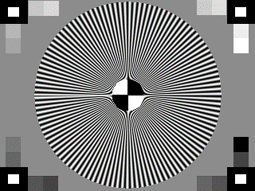
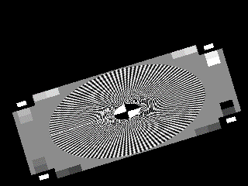
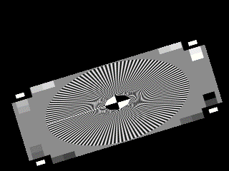
31.8 - Resulted photographs – “A31.bmp”,”A32.bmp”
“grayImage13.bmp” - Source image
“A31.bmp” - Created by using
nearest neighbor interpolation
“A32.bmp” - Created by using
bilinear interpolation

Slide 13
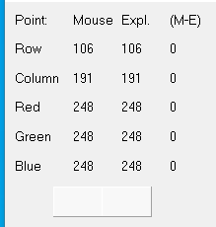
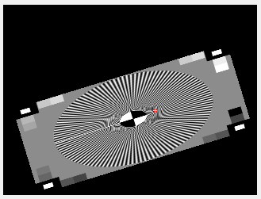
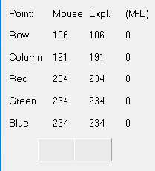

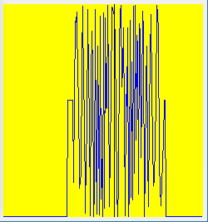
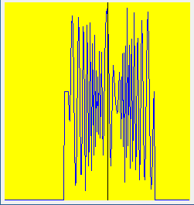
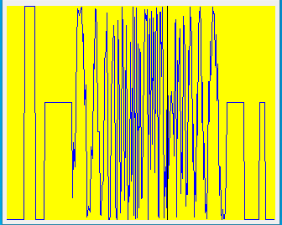
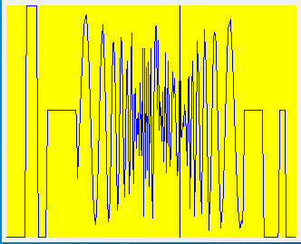
31.9 –profilers of Resulted photographs – “A31.bmp”,”A32.bmp”
A31.bmp
A32.bmp
Conclusion: “A32.bmp” looks smoother than “A31.bmp”, since we applied on it the bilinear interpolation, it can be seen in the profilers graphs. We can see that both column (left) and the row (right) have more noise in A31.bmp

Slide 14
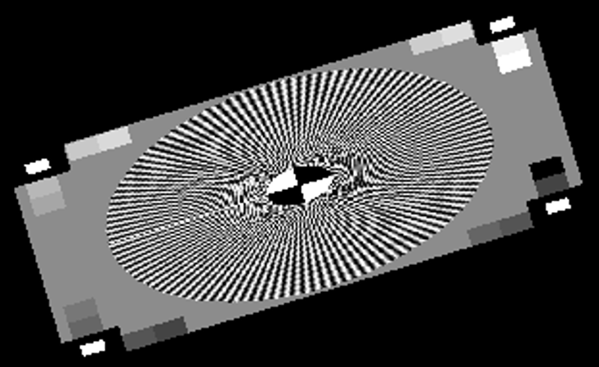
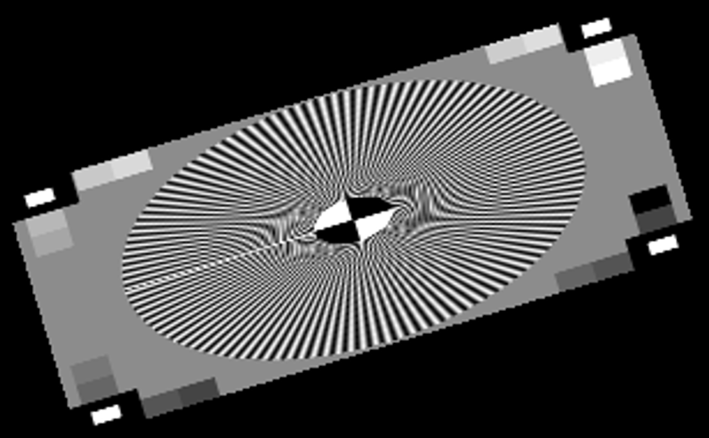
31.10 –deeper look at the results-“A31.bmp” vs ”A32.bmp”
A31.bmp
A32.bmp
1
1
3
3
4
4
2
2
The black straight lines are much more disrupted in the A31.bmp.
The small white rectangles in the corners – their outline are much more disrupted in the A31.bmp.
The area from the right hand side of the center is much more disrupted – a lot of added noise in A31.bmp.
The lines that assemble the black and white circle in the center are much more disrupted in A31.bmp.
Therefore, our opinion is that the bilinear interpolation is a way more successful method than the nearest neighbor interpolation.

Slide 15
31.8 – What did we learn ?
1) To use two algorithms that can create the same result in different ways: Bilinear interpolation and nearest neighbor.
2) To acknowledge what is interpolation and how it use it.
3) How to use Nearest Neighbor Interpolation algorithm to rotate the image.
4) How to use Bilinear Interpolation algorithm to rotate the image.
5) To apply sequence of operations on an image (move it, scale it, rotate it around the point).

